Slide 1
Enhanced matrix multiplication algorithm for FPGA
Tamás Herendi, S. Roland Major
UDT2012

Slide 2
Introduction
The presented work is based on the algorithm by T. Herendi for constructing uniformly distributed linear recurring sequences to be used for pseudo-random number generation
The most time-consuming part is the exponentiation of large matrices to an extremely high power.
An extremely fast FPGA design is detailed that achieves a speedup factor of ~1000

Slide 3
Mathematical background
The algorithm constructs uniformly distributed linear recurring sequences modulo powers of 2
The sequences can have arbitrarily large period lengths
New elements are easy to compute
Unpredictability does not hold

Slide 4
Mathematical backgound
The sequences are of the form
The coefficients are such that
holds for some P(x) irreducible polynomial
It is practical to choose P(x) to have maximal order, since the order of P(x) is closely related to the period length of the corresponding sequence.

Slide 5
Mathematical background
The sequence obtained this way does not necessarily have uniform distribution, but exactly one of the following do:
Two of them can be easily eliminated

Slide 6
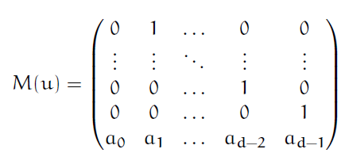
Mathematical background
Let be the companion matrix of sequence u
We need to compute
If this is the identity matrix, then the period length of u is
If it is not, then u has a uniform distribution

Slide 7
Mathematical background
Computing is done using 1 bit elements:
Multiplication modulo 2

Slide 8
Implementation
Matrix exponentiation for interesting problem sizes can quickly become very time consuming
For matrix size 1000×1000: (Intel E8400 3GHz Dual Core CPU)
Matlab implementation: ~6 minutes
Highly optimized C++ program: ~105 seconds
Previous FPGA implementation: ~0.6 seconds
New FPGA implementation (in development): ~5-10 faster than the previous version

Slide 9
FPGA
Field-programmable gate array
Creates an application specific hardware solution (like an ASIC)
Grid of computing elements and connecting elements
Reprogrammable!
Look-up tables, registers, block RAMs, special multipliers, etc.

Slide 10
Look-up table
6-LUT: look-up table with 6 bit inputs: 64 bits of memory, addressed bit by bit
By manipulating this 64 bit value, it can be configured to compute any Boolean function with 6 bit input
Arranged into a grid on the chip, organized into „slices” containing usually 2 or 4 LUTs
Some have added functionality, like being used as shift registers
Additional features to increase efficiency (registers, carry chain, etc.)

Slide 11
FPGA
Solutions are extremely efficient
Supports massive parallelism
Best at algorithms performing many operations on relatively small amounts of data at a time
Departure from traditional Von Neumann architecture

Slide 12
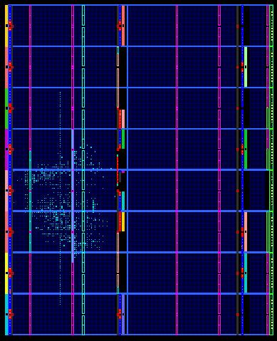
FPGA
Physically, configurations are automata networks
Creating a module takes multiple iterations: Synthesize, Translate, Map, Place & Route, Generate programming file

Slide 13
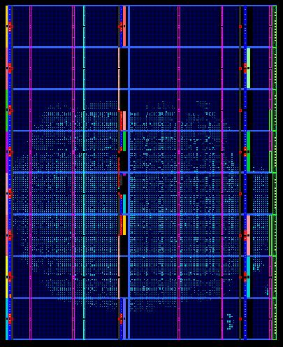
FPGA
However:
Large power consumption
Large modules take very long to compile (simulation is important)

Slide 14
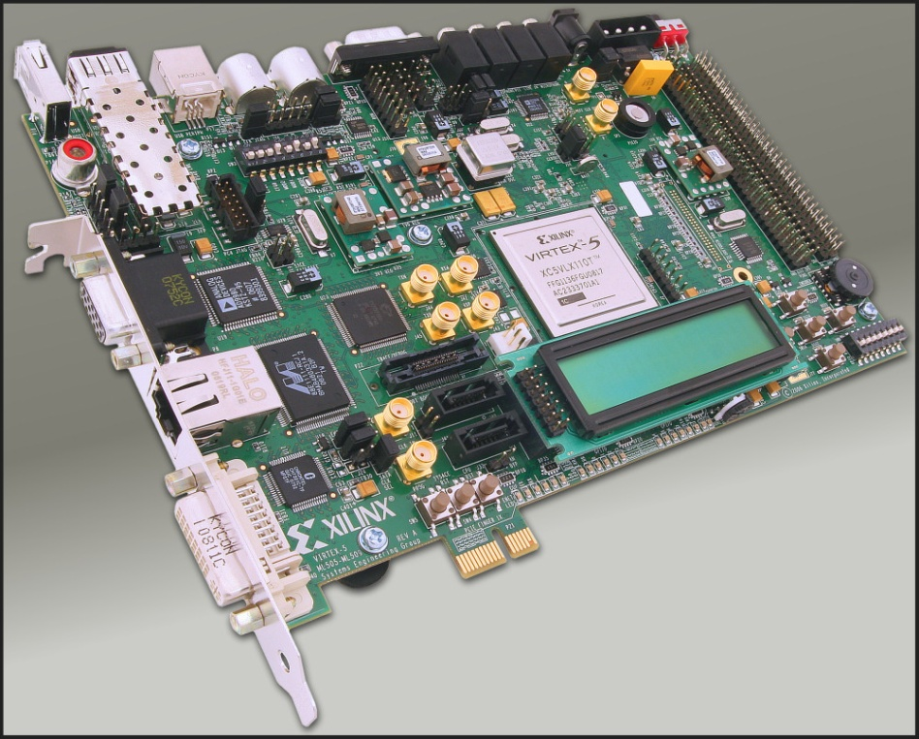
Hardware used
XUPV505-LX110T development platform
Virtex-5 XC5VLX110T FPGA
6-LUT: 64 bit look-up table
17280 Slice; 69120 LUT
17280 LUTs as 32 bit deep shift registers
148 36kb block RAM
256MB DDR2 SODIMM

Slide 15
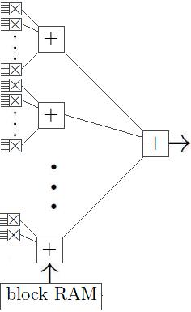
Modules
Basic LUTs:
Multiplier: 3 pairs of 1-bit elements
Adder: 6 1-bit elements
Old version: cascaded multiply-accumulate LUTs loses efficiency at higher clock rate
New version: adder tree structure
32 multiplier LUTs compute the dot product of two 96 bit long vectors
Matrix size: 1920×1920 (multiple of 96)

Slide 16
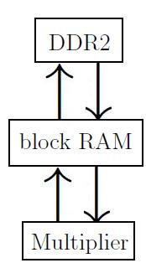
Modules
1024 such multiplier modules work in parallel, multiplying a 32×96 and a 96×32 piece of the input into a 32×32 piece of the solution in a single clock cycle (~40000 LUTs)
The multiplier is very fast compared to the main storage (DDR2, low bandwidth, high capacity)
Old version: careful control of the input flow
New version: intermediate storage (block RAM, high bandwidth, low capacity)

Slide 17
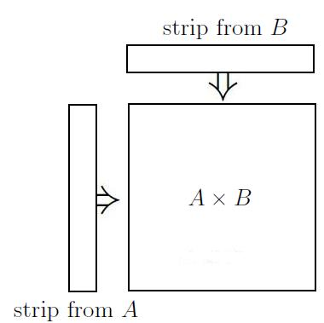
Modules
Input matrices are divided into 96×1920 strips
To maximise matrix size, the block RAM tries to contain as little from the input as possible
Using a 1920×96 and a 96×1920 strip from the input, the module computes a 1920×1920 intermediate result
Strips are iteratively read from the input, their results are accumulated together

Slide 18
Thank you for your attention.

