Slide 1
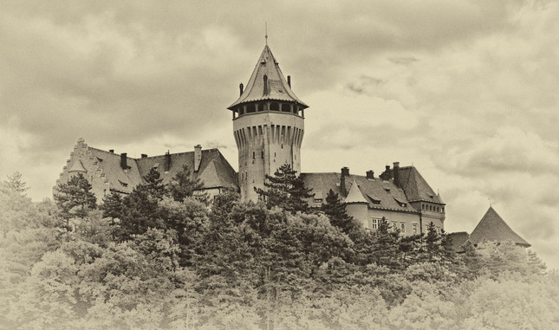

Mathematical modeling of the Covid-19 epidemic in the context of Slovakia
Smolenice 2024
Rudolf Hajossy, Marek Hyčko, Igor Mračka, Igor Odrobina, Tibor Žáčik
Mathematical Institute,
of the Slovak Academy of Sciences,
Bratislava, Slovakia

Slide 2
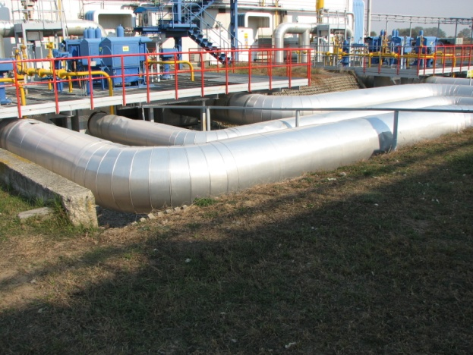
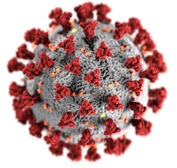

Timeline of last five years
2019
2020
2021
2022
2023
2024
Focus on Gas Pipeline Industry
Focus on Mathematical Epidemiology
Pandemic of COVID 19
Euclidean TSP
Mar. 2022
InoCHF
Sep. 2023

Slide 3
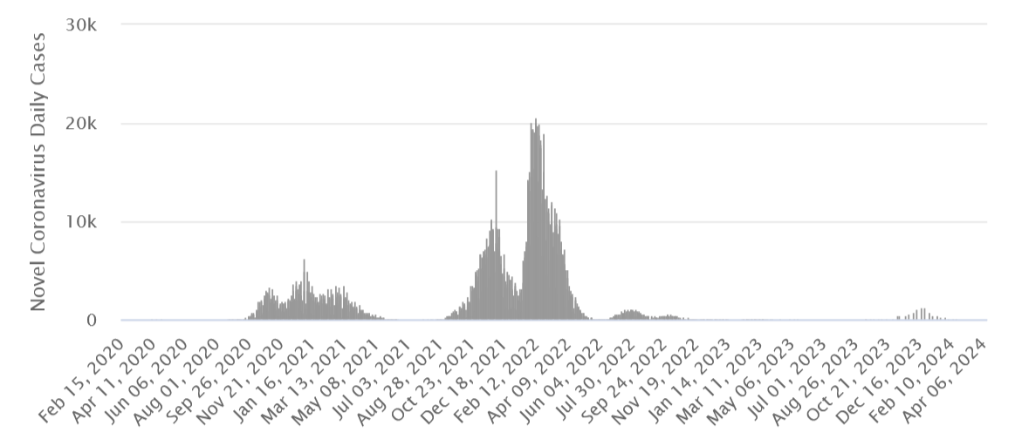
COVID-19
Marginalized communities
Pandemic traffic light
School closing
Border control
Periodic testing of population
Hospital Capacity shrinking
Antigen tests
Vaccination
Mass testing
Omicron variant
Lockdowns
Alpha variant
Delta variant
First case in March

Slide 4


MI SAS vs. COVID 19
First meeting at central of SAS
SAS will not communicate to public directly and parallelly to IZP but we will do the watchdog for IZP outputs.
Consultation with Institute for Healthcare Politics (IZP)
MI-SAS consulting a model of contact and share contact matrix with IZP.
We consult two IZP COVID-19 reports before their dissemination.
One meeting with Minister of the Interior
Two meeting with pandemic commission
One meeting with Ministry of Health
Direct financing is not possible, no interest in modeling of epidemy.

Slide 5
COVID-19
Mathematical modeling of epidemy of COVID 19 on Slovakia
  Compartmental model including 3 age groups, geography and transport patterns.
  Mote Carlo simulation over communities.
  Large scale/low detail epidemic model for analysis of impact of interstate transfer
  Cooperation with
  Institute of Geography SAS
  Institute of Physics SAS
  Institute for Sociology SAS
  Biomedical Research Center SAS
  Attempt for APVV project:
  “Simulation of COVID-19 spread dynamics and modeling of the impact of targeted epidemiological measures in the conditions of Slovakia”

Slide 6
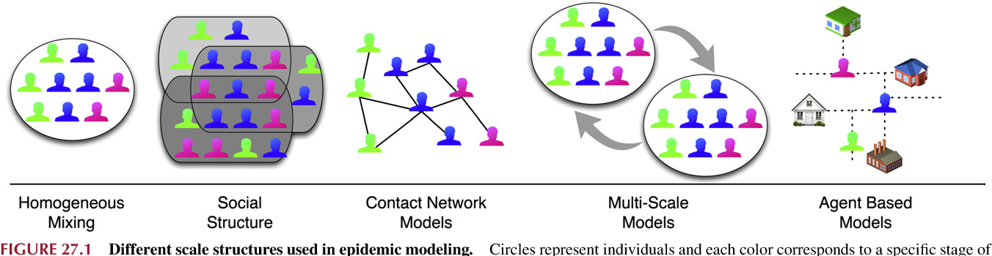
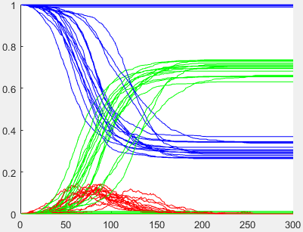
Monte Carlo simulation over communities
Demography + Social Structure + Disease transmission using random agent interaction.
For each agent, information on epidemiological status and presence in communities is maintained.
Recovered
A fraction of the total population
Susceptible
Infected
Time [days]

Slide 7
Model of social contacts
Each agent is included in several pre-generated communities.
Communities vary in size and overlap each other.
marginalized community
household
v
v
neighborhood
team for
services
friends
team / class
tourist
town
work / school
Work environment for services
The whole of Slovakia

Slide 8
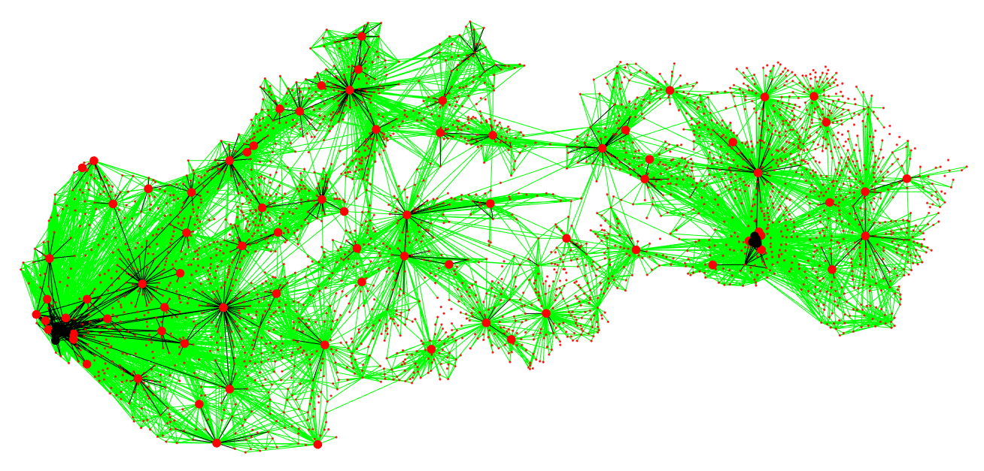
Daily commute to work
> 5 per day, > 200 per day
municipalities, district towns

Slide 9
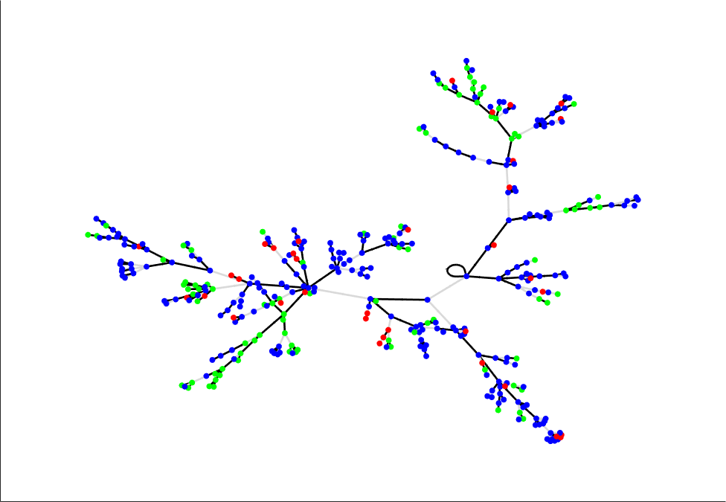
Spread of the disease around the patient 0
Nodes :
Young 0-18
Adult 19-64
Old 65-xy
Patient 0

Slide 10
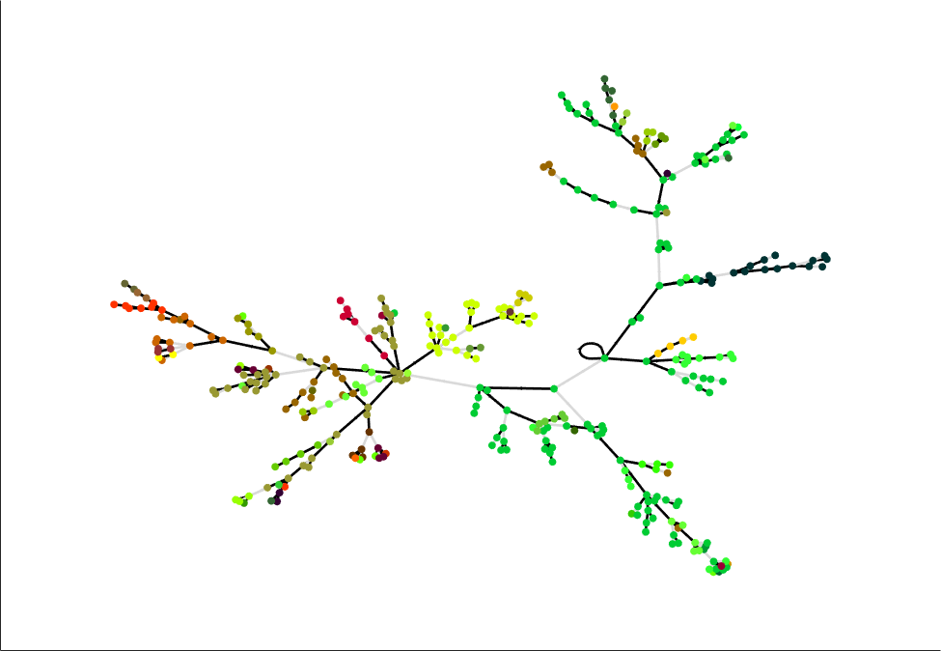
Spread of the disease around the patient 0
Nodes :
Different color means different city
Patient 0

Slide 11
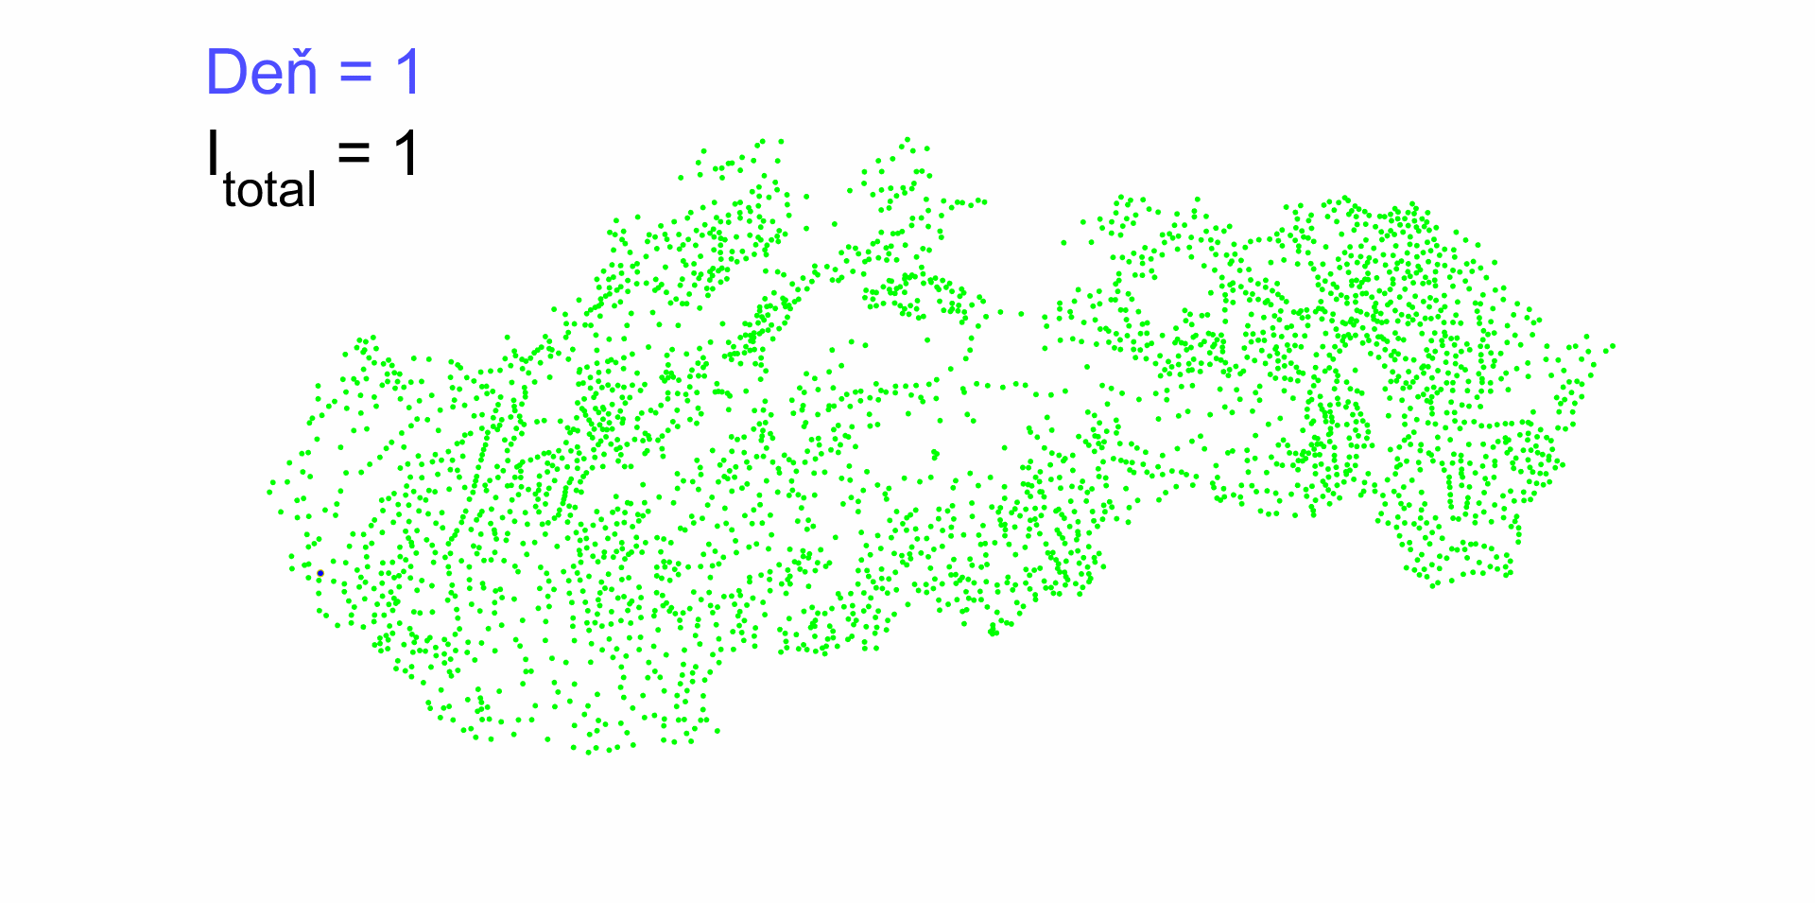
Patient 0 in Bratislava
Not one infected
At least one infected
The size of the circle represents the number of infected

Slide 12
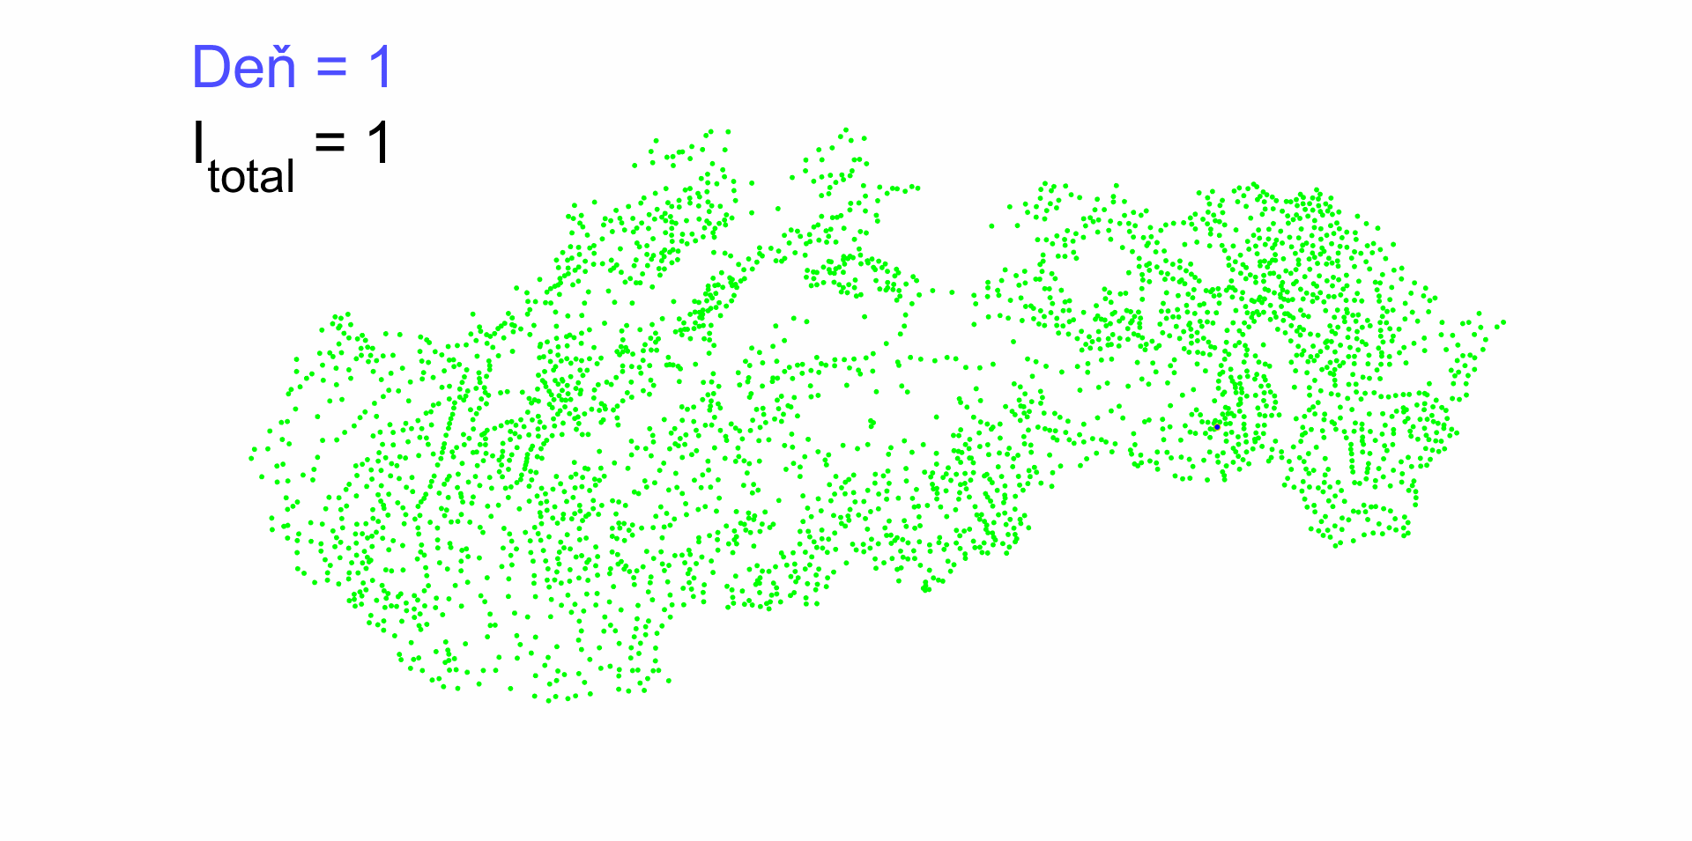
Patient 0 in Košice
Not one infected
At least one infected
The size of the circle represents the number of infected

Slide 13

Patient 0 in Červený Kláštor
Not one infected
At least one infected
The size of the circle represents the number of infected

Slide 14
Some results in mathematical epidemiology
Reproduction number R is the expected number of secondary cases produced by a typical infected individual during its entire period of infectiousness in a completely susceptible population.
For exponential phase of epidemy the growing the number of infection from generation to generation can be modeled by powering of „Next Generation Matrix“.

Slide 15
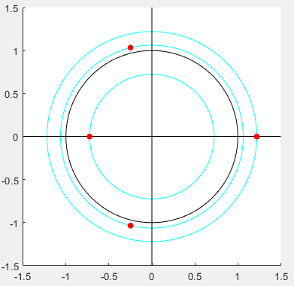
Epidemic outbreak analysis by Next Generation Matrix
without explicit knowledge of its spectral radius
Limit behavior of powering of nonnegative irreducible matrix is controlled by its spectral radius .
Imag.
For this type of models .
If outbreak occurs, otherwise outbreak not occurs.
Computation of spectral radius analytically can be very expansive
but some effective algorithm for that is known.
IDEA: Is comparison of spectral radius with predefined constant, less computational expensive than direct computation of spectral radius ?
Is it possible to derive some analytical method for that ?
What is robust and effective algorithm for such comparison ?
Real

Slide 16
Method for comparison of spectral radius of nonegative irreducible matrix with
Algorithm
Approach based on characteristic polynomial of nonnegative irreducible matrix
It opens way to radical free, power free and division free method for comparison of spectral radii of two 3x3 irreducible matrix.

Slide 17
A simple matrix model of epidemic outbreak involving the
vaccination of two age groups
Model of an exponential phase of epidemy.
Two age groups with different properties.
For each age group the vaccine is parametrized by protection against infection, spreading and hospitalization.
Each age group is partially vaccinated.
If limited number of vaccine are available,
what is optimal distribution of vaccine among age groups ?
Proposed model is complex enough to grasp nontrivial behavior and simple enough for analytical insight.
It can be shown that regardless of how bad the disease is and how good vaccination is for the old group, there is always a contact pattern for which it is optimal to prefer vaccination of the young group.

Slide 18
Periodicity of endemic state
end of Covid-19 crisis
June 1. 2022
May 31. 2023
Hospital admission (7-day average)
???
Days from July 31. 2021

Slide 19
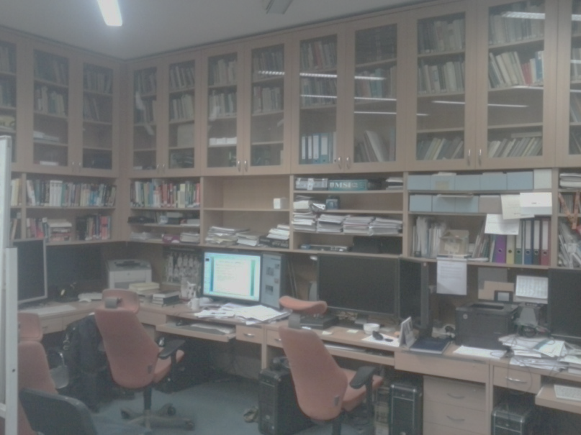
Thank you for your attention

Slide 20
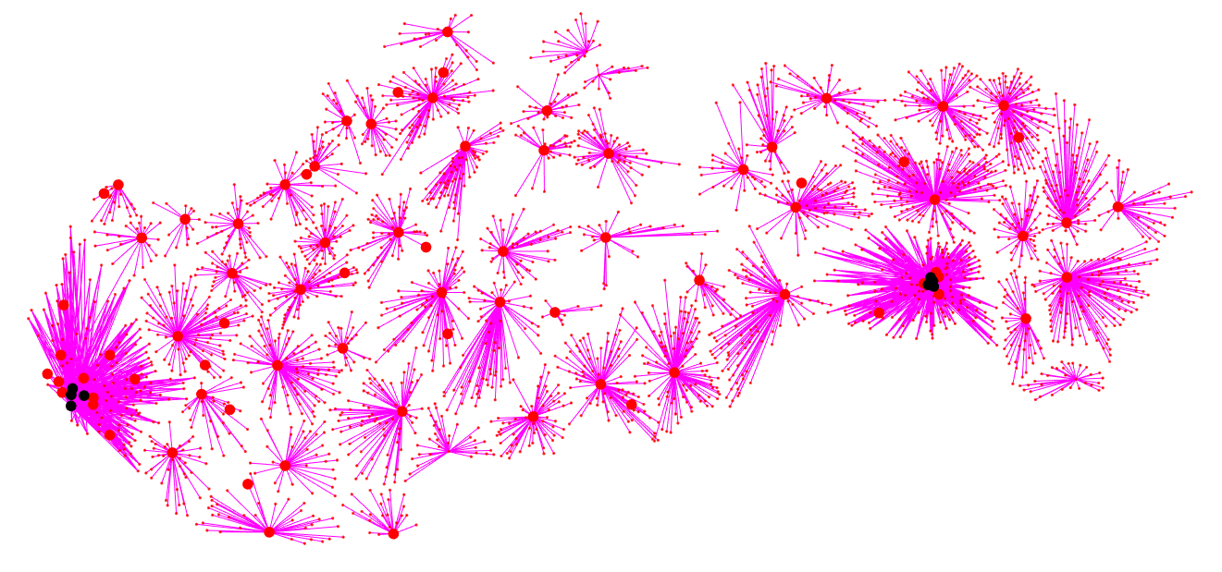
Functional urban regions (GI SAS)
connection of municipalities to FUR
district towns

Slide 21
Method for comparison of spectral radius of nonegative irreducible matrix with
Algorithm
Approach based on characteristic polynomial of nonnegative irreducible matrix
It opens way to radical free, power free and division free method for comparison of spectral radii of two 3x3 irreducible matrix.

